Slide 1

RUNGTA COLLEGE OF DENTAL SCIENCES & RESEARCH
TITLE OF THE TOPIC-
DEVELOPMENT OF DENTITION AND OCCLUSION
DEPARTMENT OF ORTHODONTICS AND DENTOFACIAL ORTHOPAEDICS

Slide 2
Specific learning Objectives
CORE AREAS | DOMAIN | CATEGORY
Introduction | AFFECTIVE | DESIRE TO KNOW
Stages Of Tooth Development | COGNITIVE | NICE TO KNOW
Predentate Stage | PSYCHOMOTOR | NICE TO KNOW
Primary Dentition | PSYCHOMOTOR | MUST KNOW
Mixed Dentition | PSYCHOMOTOR | MUST KNOW
Permanent Dentition | PSYCHOMOTOR | DESIRE TO KNOW

Slide 3
Contents
PART I
Introduction
Stages Of Tooth Development
Predentate Stage
Primary Dentition
PART II
Primary Dentition
Mixed Dentition
Permanent Dentition

Slide 4
Spacing In Deciduous Dentition
Spacing usually exists between the deciduous teeth. These spaces are called physiological spaces or developmental spaces.
The presence of spaces in the primary dentition is important for the normal development of the permanent dentition.
Absence of spaces in the primary dentition is an indication that crowding of teeth may occur when the larger permanent teeth erupt.

Slide 5
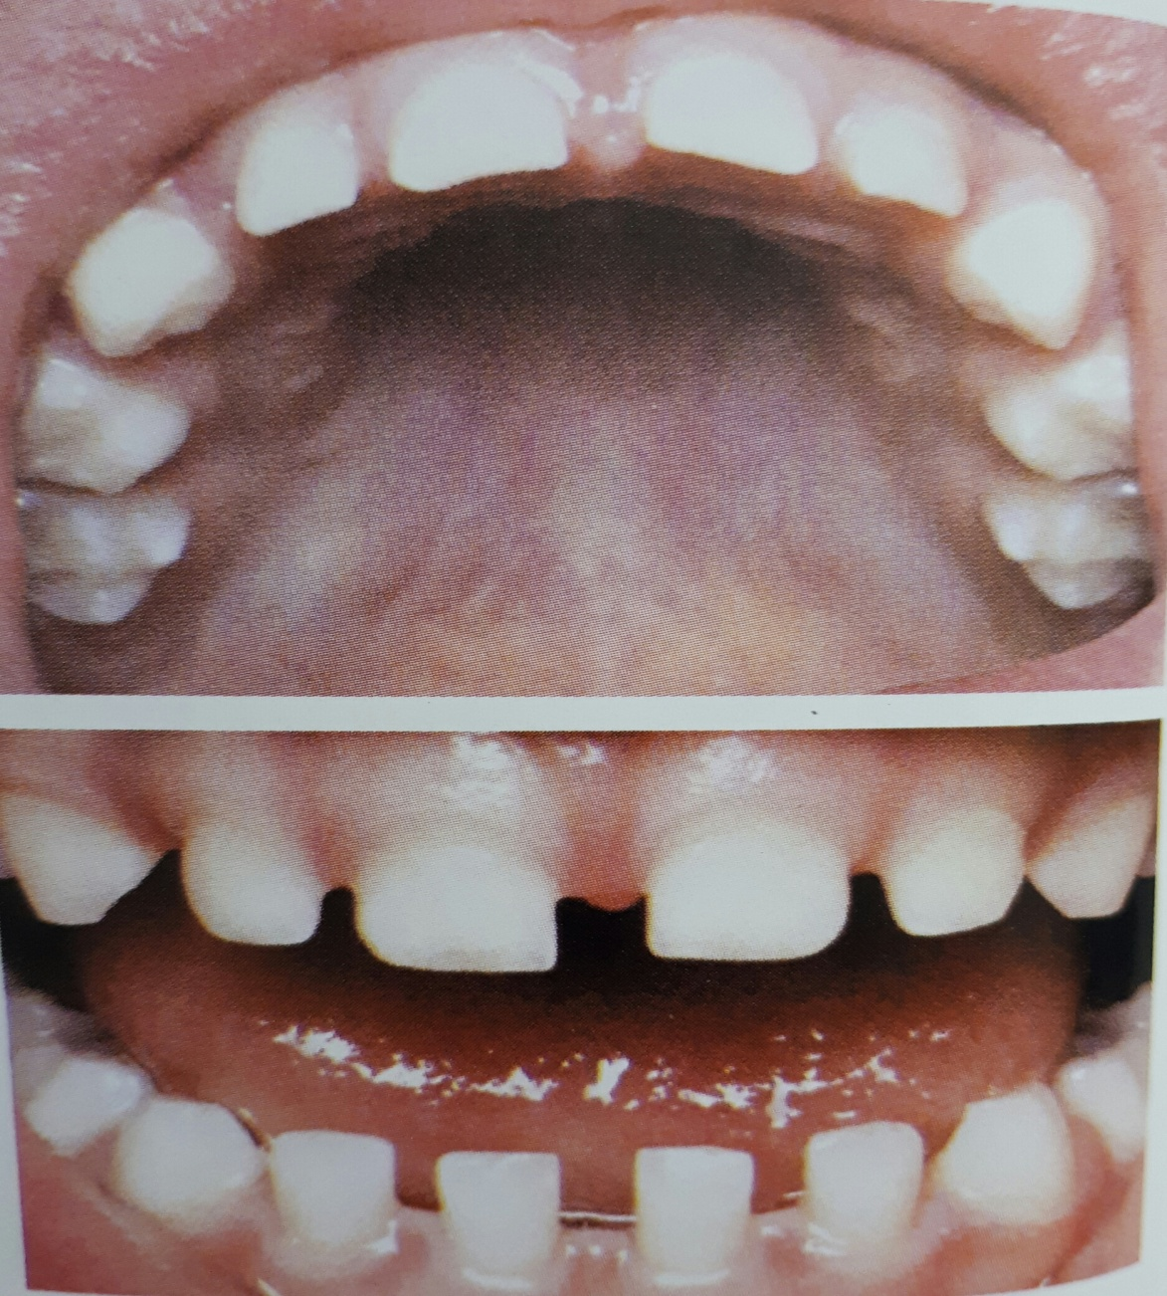
PHYSIOLOGICAL SPACE SEEN IN DECIDUOUS
DENTITON

Slide 6
Spacing invariably is seen mesial to the maxillary canine and distal to the mandibular canines. This physiological spaces are called primate spaces or simian spaces or anthropoid spaces as they are commonly seen in primates.
These spaces help in placement of canine cusps of the opposing arch.

Slide 7
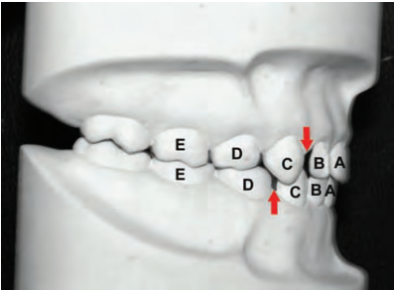
PRIMATE SPACES

Slide 8
Deep Bite In Deciduous Dentition
A deep bite may occur in the initial stages of development.
The deep bite is accentuated by the fact that the deciduous incisors are more upright than their successors.
The lower incisal edges often contact the cingulum area of the maxillary incisors.

Slide 9
This deep bite is later reduced due to following factors:
a.Eruption of deciduous molars
b.Attriton of incisors
c.Forward movement of the mandible due to growth.

Slide 10
Occlusion relation of deciduous dentition
The mesio-distal relation between the distal surfaces of the upper and lower second deciduous molars is called the terminal plane.
A normal feature of deciduous dentition is a flush terminal plane where the distal surfaces of the upper and lower second deciduous molars are in the same vertical plane.

Slide 11
Mesial step Distal surface of mandibular deciduous second molar is mesial to the distal surface of maxillary deciduous second molar.
Distal step Distal surface of mandibular deciduous second molar is more distal than the distal surface of maxillary deciduous second molar, i.e. the upper second molar occludes with two opposite teeth

Slide 12
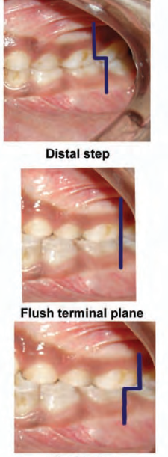
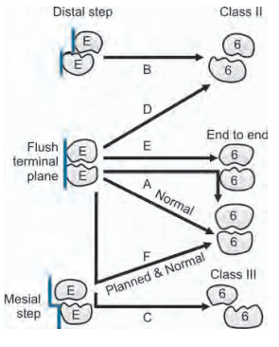

Slide 13
The mixed dentition period
The mixed dentition period becomes at approximately 6years of age with the eruption of the first permanent molars.
During the mixed dentition period, the deciduous teeth along with some permanent teeth are present in the oral cavity.

Slide 14
The mixed dentition period can be classified into 3 phases:-
1. First transitional period
2. Inter-transitional period
3. Second transitional period

Slide 15
First transitional period
It is characterized by the emergence of the first permanent molars and the exchange of the deciduous incisors with the permanent incisors.
Emergence of the first permanent molars
The mandibular first molar is the first permanent tooth to erupt around 6 years of age

Slide 16
The location and relationship of the first permanent molar depends much upon the distal surface relationship between the upper and lower second deciduous molars.
The first permanent molars are guided into the dental arch by the distal surface of the second deciduous molars.

Slide 17
The mesio-distal relation between the distal surfaces of the upper and lower second deciduous molars can be of three types:-
Flush terminal plane
The distal surface of the upper and lowe second deciduous molars are in one vertical plane, this type of relationship is called flush or vertical terminal plane.

Slide 18
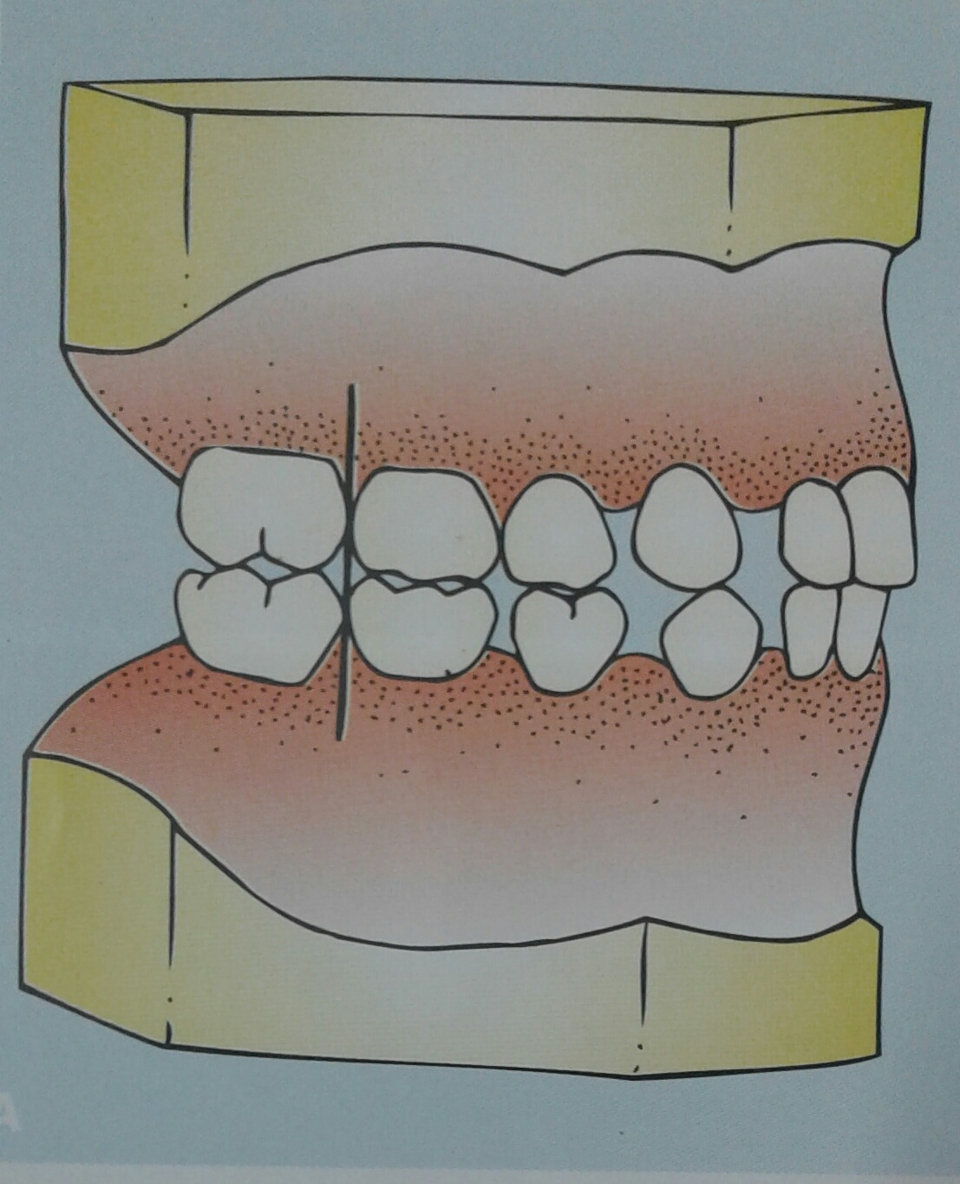
FLUSH TERMINAL PLANE

Slide 19
The erupting first permanent molars may also be in a flush or end on relationship.
For the transition of such an end on molar relation to a class 1 molar relation, the lower molar has to move forward by about 3-5 mm relative to the upper molar. This occur by the utilization of the physiologic spaces and leeway spaces in the lower arch and by differential forward growth of the mandible.

Slide 20
The shift in the lower molar from a flush terminal plane to a class 1 relation can occur into ways, they are designated as the early and late shift.
Early shift occurs during the early mixed dentition period
The eruptive force of the first permanent molar is sufficient to push the deciduous first and second molars forward in the arch to close the primate space and thereby establish a class 1 molar relationship. Since this occurs in the early mixed dentition period it is called early shift.

Slide 21
Many children lack the primate space and thus the erupting permanent molars are unable to move forward to establish class 1 relationship. In these cases, when the deciduous second molars exofoliate the permanent first molars drift mesially utilizing the leeway space.
This occurs in the late mixed dentition period and is called late shift.

Slide 22
Mesial step terminal plane
In this type of relationship the distal surfaces of the lower second deciduous molar is more mesial than that of the upper .

Slide 23
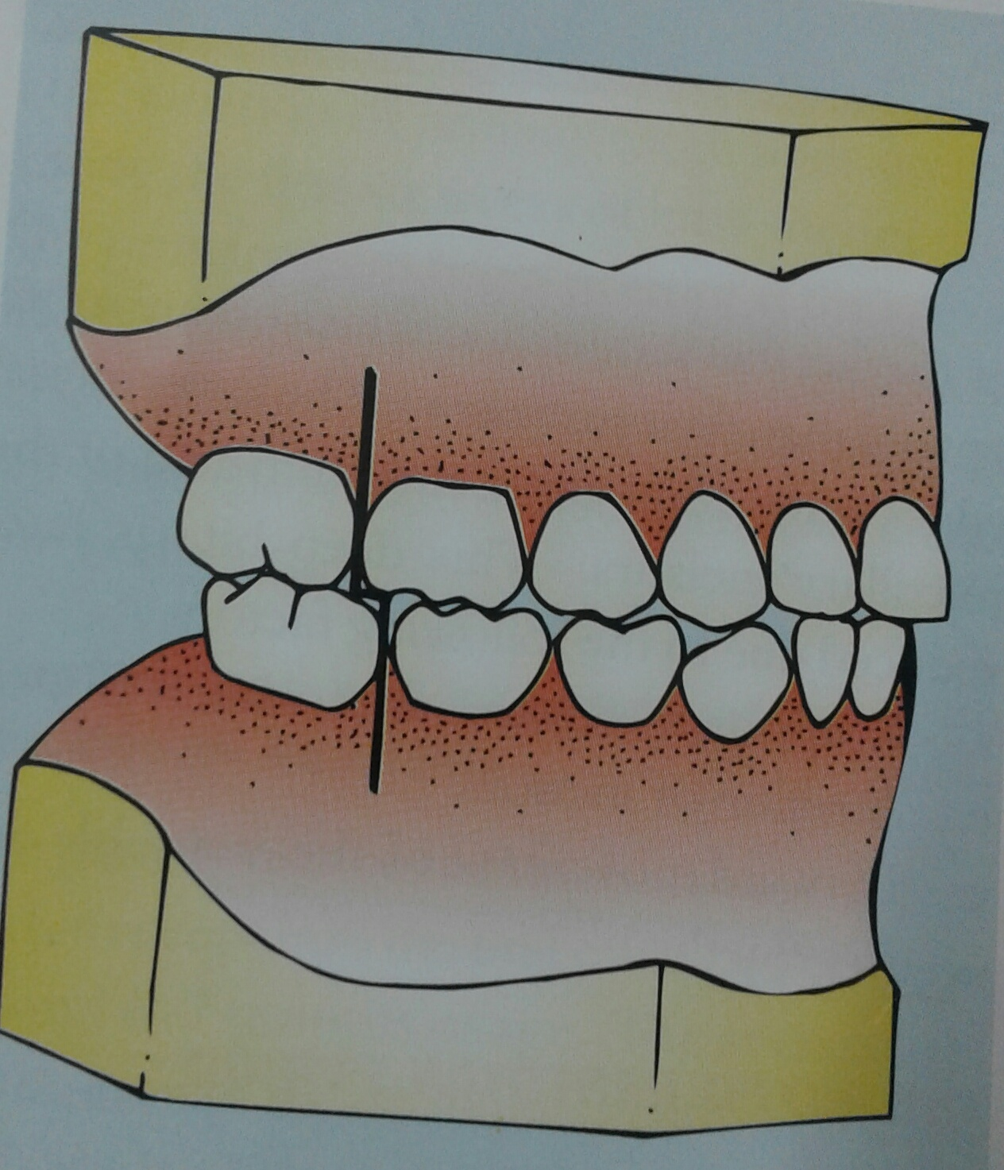
MESIAL STEP TERMINAL PLANE

Slide 24
Thus the permanent molars erupt directly into Angel’s Class 1 occlusion. This type of mesial step terminal plane most commonly occurs due to early forward growth of mandible.
If the differential growth of the mandible in a forward direction persists, it can lead to an Angel’s Class III molar relation. If the forward mandibular growth is minimal,it can establish a classI molar relationship.

Slide 25
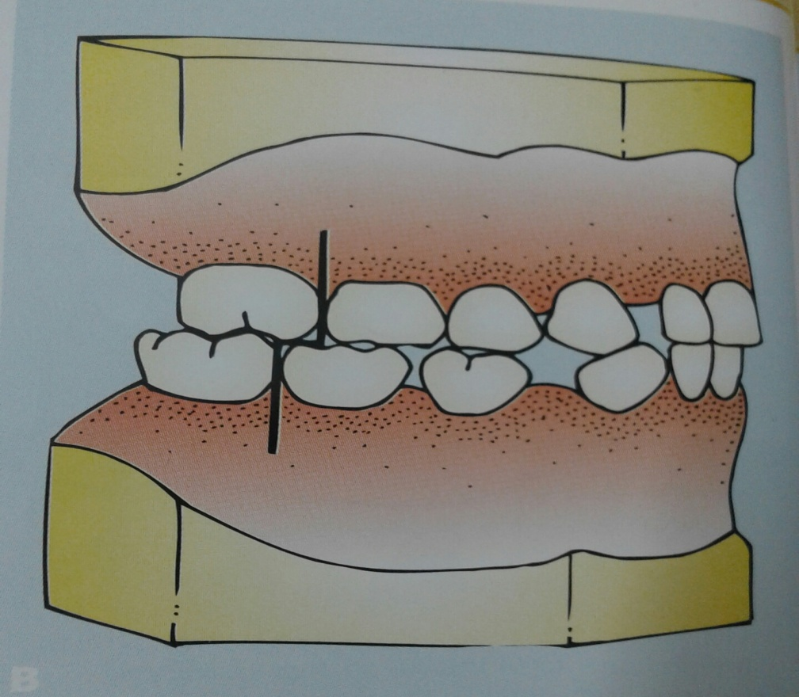
Distal step terminal plane
This is characterized by distal surface of the lower second deciduous molar being more distal to that of the upper.

Slide 26
The exchange of incisors
During the first transitional period the deciduous incisors are replaced by the permanent incisors.
The mandibular central incisors are usually the first to erupt.

Slide 27
The permanent incisors are larger than the deciduous teeth they replace. This difference between the amount of space needed for the accomodation of the incisors and the amount of space available for this is called incisal liability.
The incisal liability is roughly about 7 mm in the maxillary arch and about 5mm in the mandibular arch.

Slide 28
The incisal liability is overcome by the following factors:
a. Utilization of interdental spaces seen in primary dentition: The physiologic or the developmental spaces that exist in the primary dentition are utilized to partly account for the incisal liability. The permanent incisors are much more easily accomodated in normal alignment in cases exhibiting adequate inter-dental spaces than in an arch that has no space.

Slide 29
b.Increase in inter –canine width: During the transition from the primary incisors to the permanent incisors an increase in inter-canine width of both the maxillary as well as mandibular arch is observed. This is an important factor that allows the much larger permanent incisors to be accomodated in the arch previously occupied by the deciduous incisors.

Slide 30
C. Change in incisor inclination: One of the differences between deciduous and permanent incisors is their inclination.The primary incisors are more upright than the permanent incisors. Since the permanent incisors erupt more labially inclined they tend to increase in the dental arch perimeter. This is another factor that helps in accomodating the larger permanent incisors.

Slide 31
Inter- transitional period
In this period the maxillary and mandibular arches consist of sets of deciduous and permanent teeth.
Between the permanent incisors and the first permanent molars are the deciduous molars and canines.
This phase during the mixed dentition period is relatively stable and no change occurs.

Slide 32
The second transitional period
The second transitional period is characterized
By the replacement of the deciduous molars and canines by the premolars and permanent cuspids respectively.
The combined mesio-distal width of the permanent canines and premolars is usually less than that of the deciduous canines and molars. The surplus space is called leeway space of Nance

Slide 33
The amount of leeway space is greater in the mandibular arch than in the maxillary arch. It is about 1.8mm (0.9 mm on each side of the arch) in the maxillary arch and about 3.4 mm (1.7 mm on each side of the arch) in the mandibular arch.
This excess space available after the exchange of the deciduous molars and canines is utilized for the mesial drift of the mandibular molars to establish class I molar relation.

Slide 34
The ugly duckling stage
Sometimes a transient or self correcting malocclusion is seen in the maxillary incisor region between 8-9 years of age. This is a particular situation seen during the eruption of the permanent canines.

Slide 35
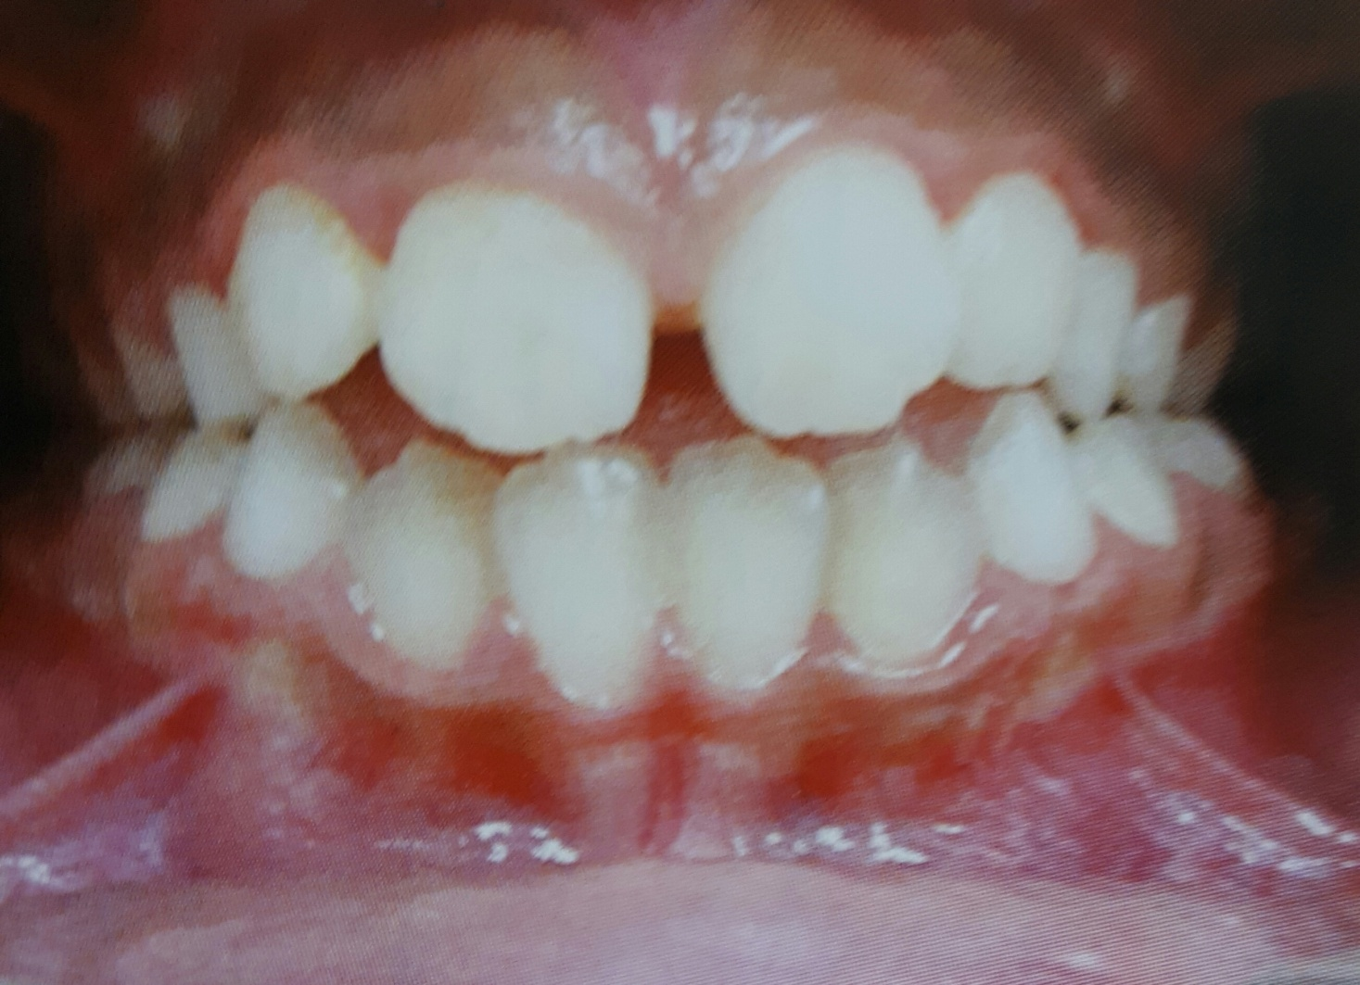
UGLY DUCKLING STAGE

Slide 36
As the developing permanent canines erupt, they displace the roots of the lateral incisors mesially. This results in transmitting of the force on to the roots of the central incisors, which also get displaced mesially. A resultant distal divergence of the crowns of two central incisors causes midline spacing. This situation has been described by Broadbent as the ugly duckling stage as children tend to look ugly during this phase of development.

Slide 37
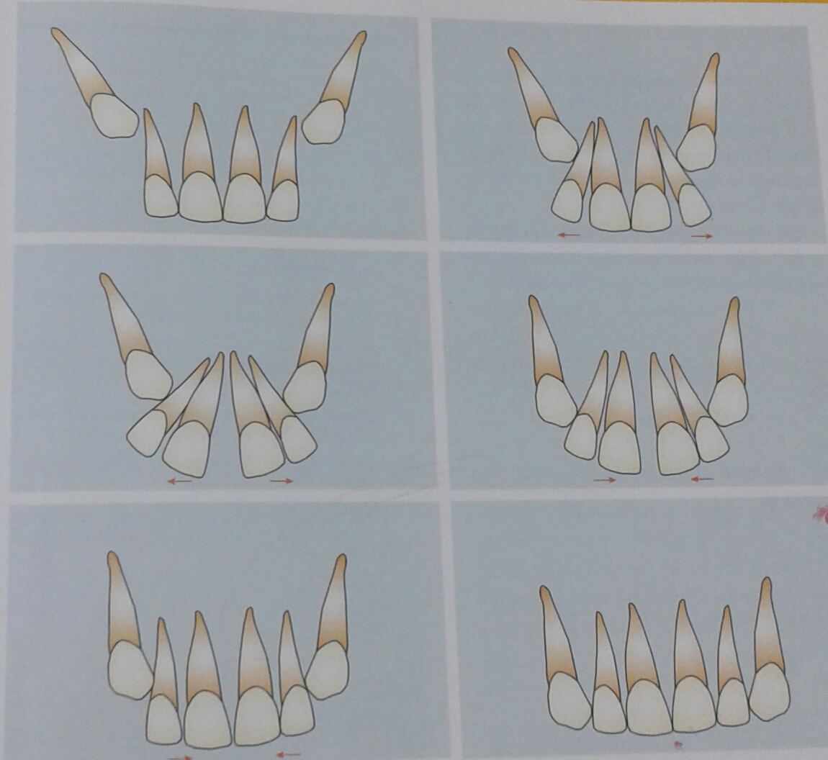
UGLY DUCKLING STAGE

Slide 38
Parents are often apprehensive during this stage and consult the dentist. This condition usually corrects by itself when the canines erupt and the pressure is transferred from roots to coronal area of the incisors.

Slide 39
The permanent dentition period
The permanent dentition forms within the jaws soon after birth, except for the cusps of the first molars, which form before birth.
The permanent incisors develop lingual or palatal to the deciduous incisors and move labially as they erupt.

Slide 40
The premolars develop below the diverging roots of the deciduous molars.
The eruption sequence of the permanent dentition may exhibit variation. The frequently seen sequences in the maxillary arch are:
6-1-2-4-3-5-7 or
6-1-2-3-4-5-7.
In case of the mandibular arch the sequence is : 6-1-2-3-4-5-7 or
6-1-2-4-3-5-7

Slide 41
Summary
Development of dentition in humans is complex and depends on many variables.
Development of dentition deviates markedly from that of other parts and structures of the body.
Crowns of teeth are formed directly to adult size and housed within the jaws years before they emerge.
To determine an abnormal course of development, it is the responsibility of an orthodontist to have adequate knowledge on the subject to differentiate abnormal from normal before initiating therapy.

Slide 42
REFERENCES
Textbook of Orthodontics – Gurkeerat Singh, Jaypee Brothers; 2nd Edition
Orthodontics – The Art and Science, S.I Bhalajhi, AryaMedi Publishing; 7th Edition
Textbook of Orthodontics – Sridhar Premkumar, Elsevier; 1st Edition
Orthodontics: Diagnosis and Management of Malocclusion and Dentofacial Deformities – O.P Kharbanda, Elsevier; 1st Edition

Slide 43
Question & Answer Session

